Slide 1

World Happiness Project
Jason Cook
Michael Park
Tammy Ura-Aguilar

Slide 2
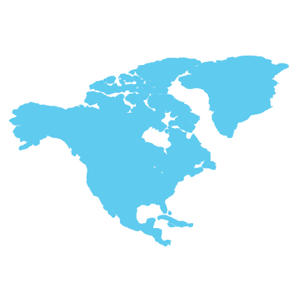
World Happiness Report
The World Happiness Report is a landmark survey of the state of global happiness. The reports review the state of happiness in the world today and show how the new science of happiness explains personal and national variations in happiness. Ranks 155 countries by their happiness levels; released at the United Nations at an event celebrating International Day of Happiness on March 20th. The report continues to gain global recognition and is used to describe how measurements of well-being can be used effectively to assess the progress of nations.

Slide 3

How is Happiness measured?
The happiness score and ranking use data from Gallup World Poll. The scores are based off of The Cantril Self-Anchoring scale, that consists of :
Respondents imagining a ladder with steps numbered from zero at the bottom to 10 at the top.
The top of the ladder represents the best possible life for you and the bottom of the ladder represents the worst possible life for you.
On which step of the ladder would you say you personally feel you stand at this time?
3

Slide 4

Six factors for Life Evaluation:
Economic production - GDP per capita in purchasing power parity (PPP); adjustment factor of 1.17 between 2005 PPP to 2011 PPP to account for changes in implied prices
Social support - national averages of binary answers (0 or 1) in response to “Do you have someone to count on in times of trouble?”
Life expectancy - World Health Organization (WHO) data repository
Freedom – national average of responses to “Are you satisfied with your freedom to make life choices?”
Absence of corruption – average of 2 (0-1) responses regarding corruption
Generosity - residual of regressing national average of response to the GWP question “Have you donated money to a charity in the past month?” on GDP per capita
4

Slide 5
Data Cleanup & Analysis
We had to merge 5 World Happiness csv files
We realized not every year had the same amount of countries, columns, and country names
5 countries did not have the same spelling through the files, so we renamed them to match.
20 countries were not in every year
Removed all the the NaNs
Removed columns that were not in every file
Renamed columns names to match all the files
Countries Not in Every Year
Angola | Namibia
Belize | North Macedonia
Central African Republic | Oman
Comoros | Puerto Rico
Djibouti | Somalia
Gambia | Somaliland region
Laos | South Sudan
Lesotho | Sudan
Macedonia | Suriname
Mozambique | Swaziland
Name | Rename to match other files
Hong Kong S.A.R., China | Hong Kong
Taiwan Province of China | Taiwan
Trinidad and Tobago | Trinidad & Tobago
North Cyprus | Northern Cyprus
Somaliland region | Somaliland Region

Slide 6
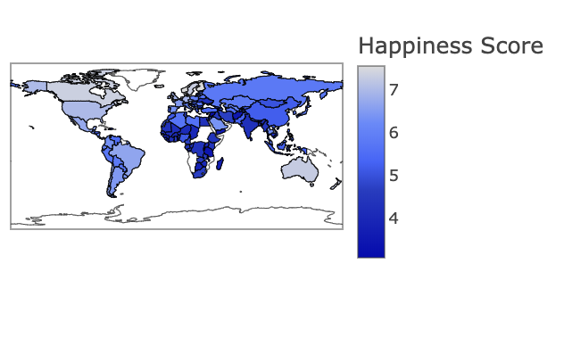
Average Happiness Score
6

Slide 7
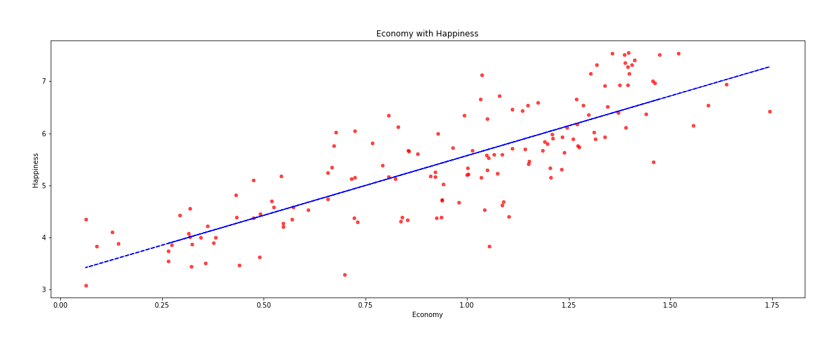
Economy to Happiness Scatter plot with regression line fit
7

Slide 8
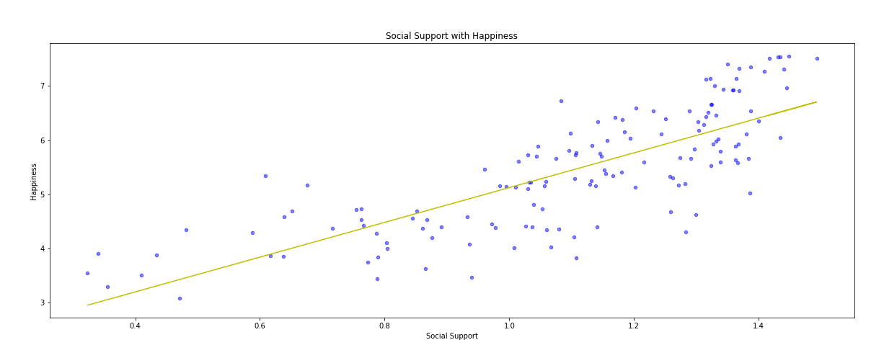
Social Support to Happiness Scatter plot with regression line fit
8

Slide 9
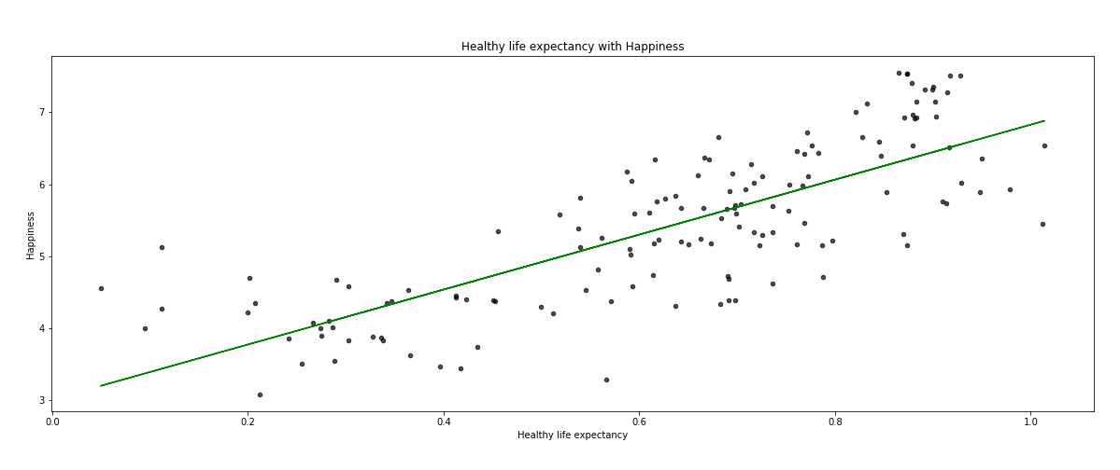
Life Expectancy to Happiness Scatter plot with regression line fit
9

Slide 10
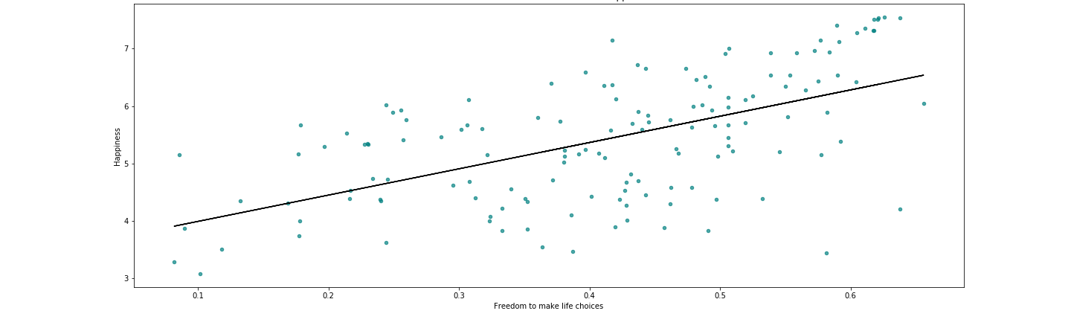
Freedom to Happiness Scatter Plot with regression line fit
10

Slide 11
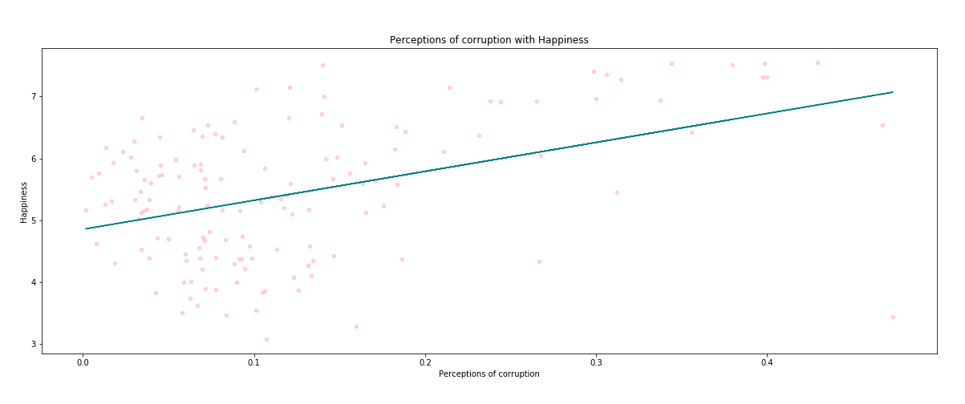
Corruption to Happiness Scatter plot with regression line fit
11

Slide 12
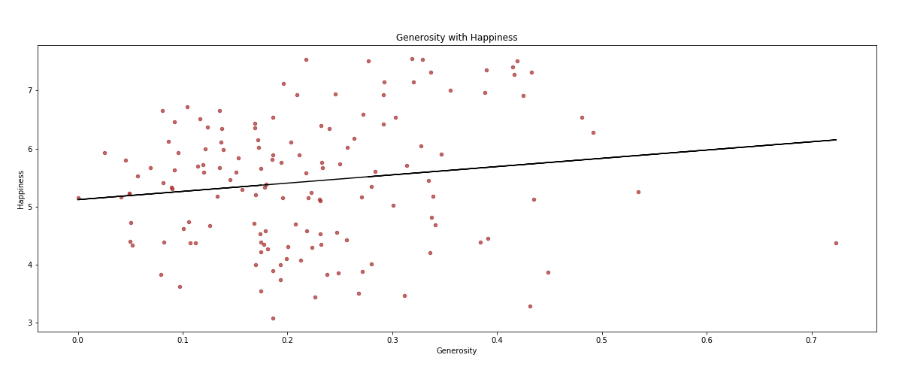
Generosity to Happiness Scatter plot with regression line fit
12

Slide 13
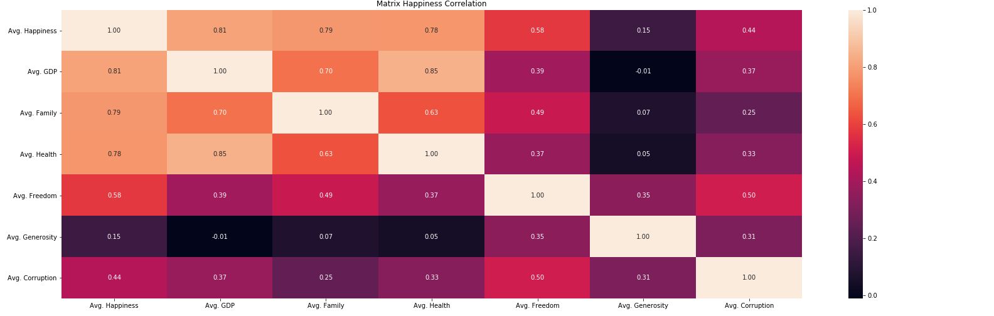
World Happiness Correlation Matrix
13

Slide 14

For more information:
https://worldhappiness.report/

